Slide 1
Twitter
APIs for data mining and the impacts of technology on social, cultural, ethical, privacy, safety and regulations
By Denise Kutnick and Geoffrey Stoner

Slide 2
Introducing the APIs
REST (Representational State Transfer) – Most APIs are categorized here
Streaming APIs – Live updates of public data
Fabric APIs – Easily integrate Twitter, everywhere

Slide 3
REST APIs
Must be authorized using OAuth
Rate Limits – Cannot send over a certain number of requests
Responses are received in JSON (JavaScript Object Notation)
Two types of commands – GET and POST
GET – Mines data
POST – Sends data

Slide 4
REST APIs – Sample GET
GET /1.1/help/languages.json HTTP/1.1
Host:
api.twitter.com
X-Target-URI:
https://api.twitter.com
Connection:
Keep-Alive
Authorization:
OAuth oauth_consumer_key="****",oauth_signature_method="****",oauth_timestamp="****",oauth_nonce="****",oauth_version="****",oauth_token="****",oauth_signature="****"

Slide 5
REST APIs – Sample GET continued
{
"code": "ja",
"name": "Japanese",
"status": "production"
},
{
"code": "es",
"name": "Spanish",
"status": "production"
},

Slide 6
Twitter Search API to find tweets on “Earthquake”
<html>
<head>
<script type="text/javascript" src="https://ajax.googleapis.com/ajax/libs/jquery/1.6.2/jquery.min.js"></script>
<script type="text/javascript">
$(document).ready(function() {
$.getJSON('http://search.twitter.com/search.json?q=earthquake&lang=en&callback=?', function(data) {
var data = data.results;
var html = "<ul>";
for(var i=0; i<data.length; i++) {
html += "<li><a href='http://twitter.com/" + data[i].from_user + "'>@"
+ data[i].from_user + "</a>: " + data[i].text + "</li>";
}
html += "</ul>"
$('.content').html(html);
});
});
</script>
</head>
<body>
<h2>Twitter</h2>
<div class="content">
</div>
</body>
</html>

Slide 7
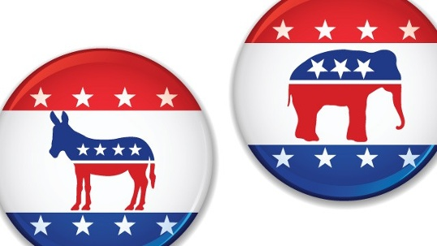
Interesting Websites Using Twitter’s Rest APIs
Civic minded individuals can see a Q/A from constituents and representatives http://www.askthem.io/locator?q=florida
NY Times site using twitter API to parse election results and news http://elections.nytimes.com/2010/updates

Slide 8
Case Study – JibJab
Goal: Wanted to integrate users’ Twitter feeds into the app, wanted to make it easier to share GIFs directly from the app
Solution: Twitter Kit
Allows for requests to the REST APIs
Twitter API Client function
Secure OAuth Echo support
No JSON parsing needed
Customizable colors for buttons, etc.

Slide 9
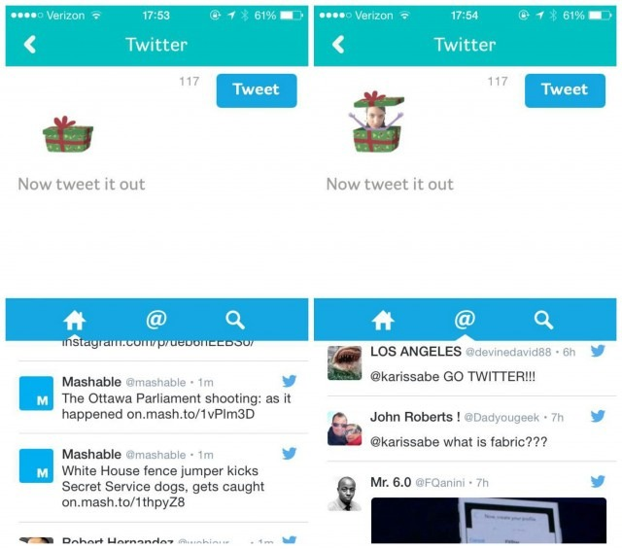

JibJab – Embedding a GIF

Slide 10
Streaming APIs
Live updates of data
No rate limits
Public streams – Everyone’s data
Post requests for public streams allow for more filters
User streams – One person’s data
Site streams – Multiple user streams
User & Site streams – REST API Fallback

Slide 11
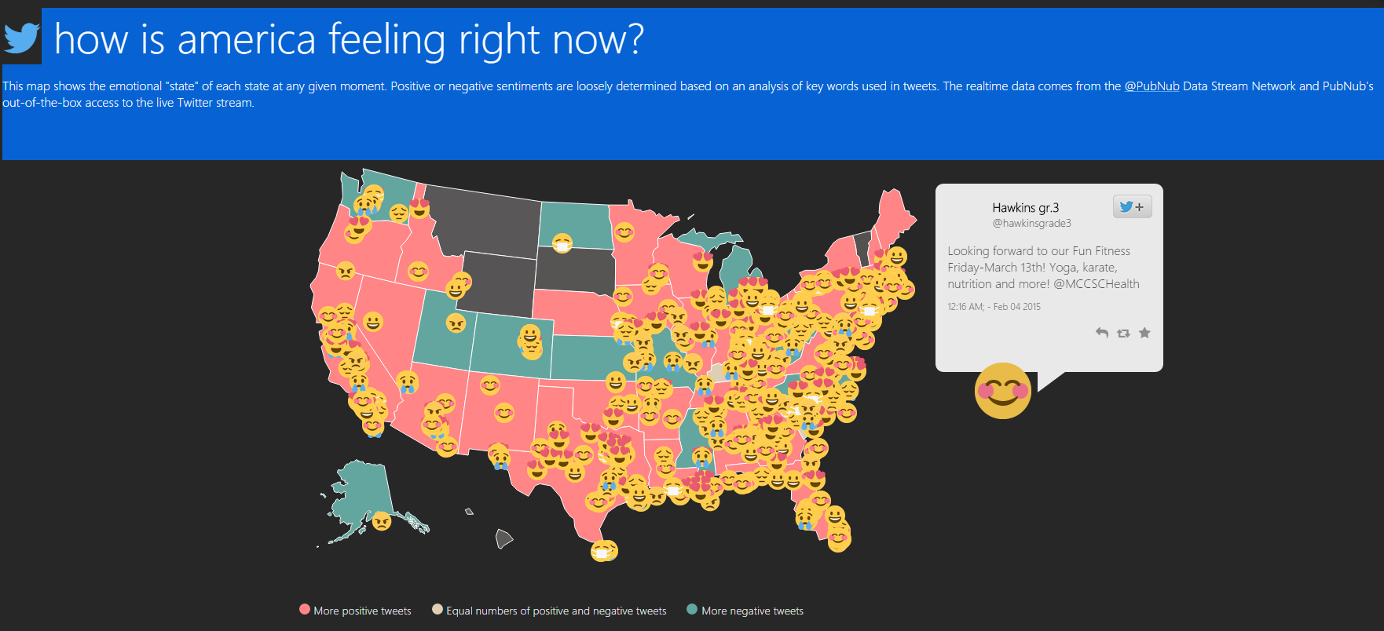
Using Twitter Streaming API to graphically represent “How America is feeling Right Now”
http://pubnub.github.io/tweet-emotion/
Source Code

Slide 12
Case Study – Esri
Goal: Wanted to use locations of Tweets to map weather trends in real time
Streaming APIs
No rate limits
Filtered information for more precise data mining
More information obtained this way when compared to the REST APIs

Slide 13
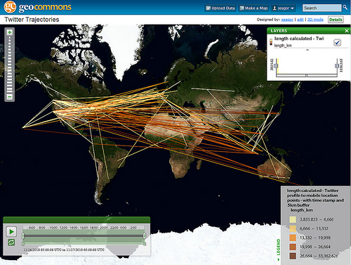
Esri – Black Friday Shopping

Slide 14
Big Data Big Promises
Large-scale data sets of human behavior have the potential to fundamentally transform our methods
We fight diseases
Design cities
Perform research.
Establish patterns of behavior

Slide 15
Metadata
Created on a large scale by ubiquitous technology
Smartphones
Apps
GPS – Location Services
Photo geotagging
Tweets, Likes, Status Updates, etc
Cellphone triangulation
Call Records
Credit Card Purchases
Web Browsing

Slide 16
Metadata and Privacy – MIT Study
A study 3 months of credit card records for 1.1 million people and show that four spatiotemporal points are enough to uniquely re-identify 90% of individuals.
They show that knowing the price of a transaction increases the risk of re-identification by 22%, on average.
They show that even data sets that provide coarse information at any or all of the dimensions provide little anonymity and that women are more identifiable than men in credit card metadata.

Slide 17
MIT Study - Privacy
De Montjoye's team analyzed 3 months of credit card transactions chronicling the spending of 1.1 million people in 10,000 shops in a single country analyzed information from a “major bank,”
The bank anatomized the data. Stripped off names, credit card numbers, shop addresses, and even the exact times of the transactions.
All that remained were the metadata: amounts spent, shop type—restaurant, gym, or grocery store, for example—and a code representing each person, because each individual's spending pattern is unique, the data have a very high “unicity.”
To do a “correlation attack” reveal a person's identity, you just need to correlate the metadata with information about the person from an outside source like check-ins on twitter, facebook or 4square.

Slide 18
MIT Study - Continued
The MIT team simulated a correlation attack on the credit card metadata. Geolocated tweets or mobile phone apps that log location. The computer used those clues to identify some of the anonymous spenders.
The researchers then fed a different piece of outside information into the algorithm and tried again, and so on until every person was de-anonymized.
Just knowing an individual's location on four occasions was enough to fingerprint 90% of the spenders.
And knowing the amount spent on those occasions made it possible to de-anonymize nearly everyone and trace their entire transaction history with just three pieces of information per person.
The findings echo the results of a 2013 Scientific Reports study in which de Montjoye and colleagues started with a trove of mobile phone metadata on subscribers' movements and showed that knowing a person's location on four occasions was enough to identify them.

Slide 19
Fabric APIs
A set of APIs with multiple uses
Combines REST APIs with useful stats
Cross-platform, can be used with several IDEs
App Stability – Crashlytics
Identity – Digits, Twitter Log In
Distribution – Twitter Social
Mobile Analytics – Answers
Monetization – MoPub

Slide 20
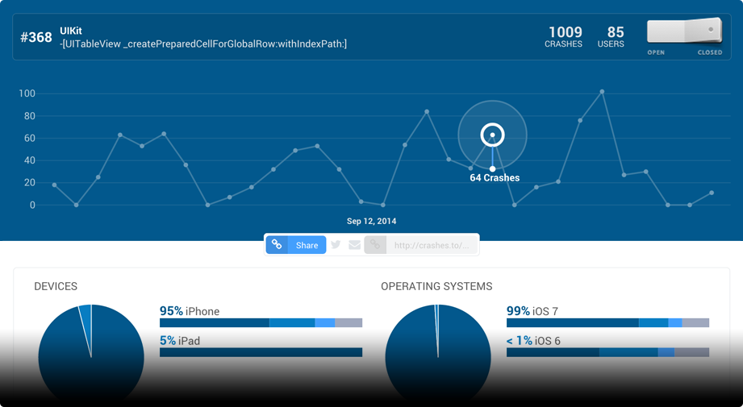
Crashlytics – The Exception Handler

Slide 21
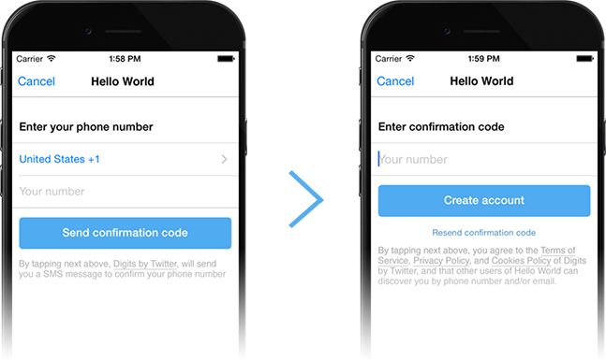
Digits – Easy Identification

Slide 22

Twitter Social – Customizing Twitter

Slide 23
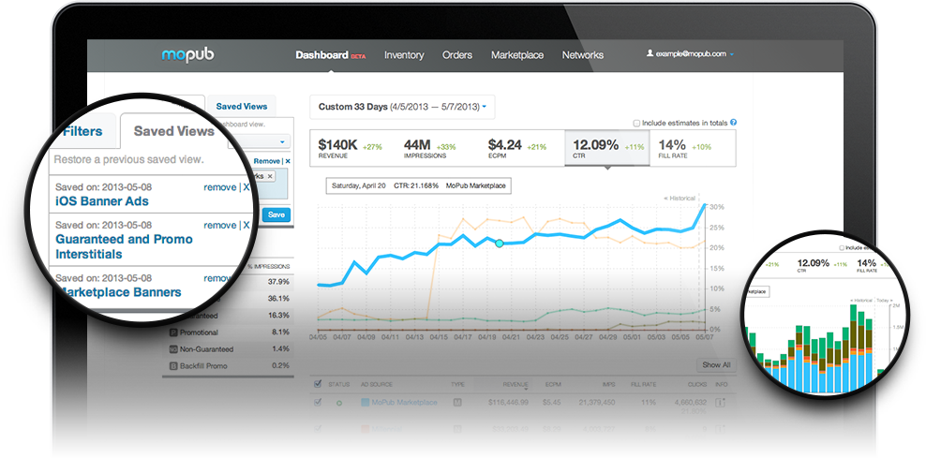
MoPub – Winning Customers Over

Slide 24
Case Study – Buzzfeed
Goal: Aimed to reduce crash rates for its 150+ million users
Crashlytics (Part of the Fabric SDK)
Pinpoints state of the device when exceptions are thrown
Data collected regardless of whether throw/catch exists
Issues alerted in real time
Stack trace analysis
Goal: Wanted to make it easier to share stories on Twitter
Twitter Social (Also part of the Fabric SDK)
One tag in XML embeds a tweet
Made possible by the TweetUI Kit for Android and the REST APIs for iOS

Slide 25
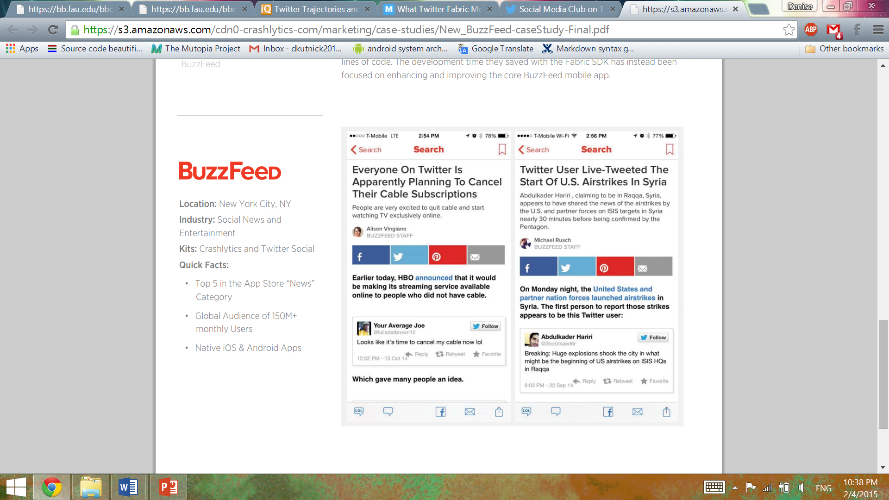
Buzzfeed – Tweet Embedding

Slide 26
Case Study – Halfbrick Studios
Goal: Wanted to make money through their advertisements and add some personalization
MoPub
Better ad management
Personalized advertisements with just a few lines of code
Doubled the revenue of advertisements
Real time bidding – advertisers are in control of the apps their ads appear in

Slide 27

Halfbrick Studios – Raking in App Revenue

Slide 28
MoPub – Studying the Issues
Amy uses her smartphone to shop for shoes at Zappos.com and she takes a break from shopping to play Rovio's Angry Birds.
Rovio's server instantly recognizes Amy based on her phone's unique device ID (a sort of online fingerprint).
It takes this information to the MoPub ad exchange, where it solicits bids for the right to show Amy an advertisement in between her rounds of killing pigs.
Zappos, disappointed that Amy recently left its website without buying anything, might pay Rovio a premium for the right to show her its ad in the hope of luring her back with, say, a picture of those metallic gold pumps she'd lingered on.
Twitter has in its possession a digital Rosetta Stone that enables it to know who you are, wherever you are to a point.
While MoPub knows a lot about which websites and apps Amy has used, there's still a lot that it doesn't know. If Amy sets down her phone and buys those gold pumps using her laptop, MoPub (and Rovio and Zappos) won't know that she's the same person who was just playing Angry Birds. That's because MoPub doesn't actually know who Amy is. It knows her device IDs, but not the fact that they're linked to Amy, this person who enjoys playing Angry Birds and shopping for pumps.
However, Amy has no way of knowing that Twitter enabled the Zappos ad on her Angry Birds screen.

Slide 29
Effects
Much of the data Twitter collects about you doesn't actually come from Twitter.
“Tweet" buttons are embedded on websites and apps function as tracking devices.
Any website with a "tweet" button—from Cnn.com to ZDNet.com—automatically informs Twitter that you've arrived.
Twitter announced that it would start using its knowledge of your internet browsing habits to better recommend people to follow on Twitter.
identity brokers such as Acxiom, which will match personal Twitter accounts with the detailed consumer profiles that they keep on millions of Americans.

Slide 30
Differential Privacy
Big data with sensitive information could live “in the cloud,” protected by gatekeeper software
The gatekeeper would not allow access to individual records, thwarting correlation attacks, but would still let researchers ask statistical questions about the data.
A set of standards and algorithms known as differential privacy works best when you have a large amount of data.
This is a stark departure from the traditional academic practice of open data sharing, and many scientists are resistant.
With safeguards, rich databases beyond twitter and social could be opened up.
Opening up data for research without endangering privacy could do a lot of good for searching moods, opinions, social unrest as well as commerce.

Slide 31
Twitter and Privacy
Twitter has proven highly sensitive to privacy concerns.
Having learned from Facebook's mistakes early on, it publishes an easy-to-understand privacy policy that allows users to quickly opt out of its tracking functions and respects the do-not-track settings in internet browsers.
It also has earned public trust by resisting and exposing government efforts to subpoena Twitter users' data—to the extent that the Electronic Frontier Foundation named it the best large tech company for protecting your data from the government.

Slide 32
Works Cited
Bohannon, John. "Credit Card Study Blows Holes in Anonymity." Credit Card Study Blows Holes in Anonymity. Science Magazine, 30 Jan. 2015. Web. 01 Feb. 2015.
Harkenson, Josh. "Is Twitter about to Get More Invasive than Facebook?" Mother Jones. Mother Jones and the Foundation for National Progress., 23 Sept. 2013. Web. 02 Feb. 2015.
Imura, Tomomi. "Tweet Emotion: Real-time Tweet Analysis with PubNub Data Stream | Twitter Blogs." Tweet Emotion: Real-time Tweet Analysis with PubNub Data Stream | Twitter Blogs. Developer Blog, 5 Dec. 2014. Web. 04 Feb. 2015.
Jarmul, Katharine. "How to Use APIs from Twitter, Google & Facebook to Find Data, Ideas." Poynter. Poynter.org, 25 Nov. 14. Web. 04 Feb. 2015.
Scheinkman, Andrei. "Search Results Twitter - Open Blog - NYTimes.com." Open Search Results for Twitter. New York Times, 15 June 2011. Web. 04 Feb. 2015.
Tucker, Patrick. "Has Big Data Made Anonymity Impossible?" TechnologyReview.com. MIT Technology Review, 30 Jan. 2015. Web. 02 Feb. 2015.

Slide 33
Works Cited – Continued
https://s3.amazonaws.com/cdn0-crashlytics-com/marketing/case-studies/JibJab-caseStudy-1b.pdf
https://dev.twitter.com/twitter-kit/overview
https://dev.twitter.com/twitter-kit/android/oauth-echo
https://get.fabric.io/native-social
https://get.fabric.io/crashlytics
https://s3.amazonaws.com/cdn0-crashlytics-com/marketing/case-studies/New_BuzzFeed-caseStudy-Final.pdf
https://dev.twitter.com/twitter-kit/android/tweetui
https://dev.twitter.com/twitter-kit/ios/show-tweets
https://dev.twitter.com/products/native-social
https://dev.twitter.com/mopub/android/getting-started
https://dev.twitter.com/mopub/android/banner
https://s3.amazonaws.com/cdn0-crashlytics-com/marketing/case-studies/Halfbrick_casestudy.pdf
http://www.mopub.com/
https://dev.twitter.com/case-studies/esri-enriches-maps-tweets-and-streaming-api
http://blog.dc.esri.com/2011/01/10/twitter-trajectories-and-our-ever-shrinking-small-world/
https://dev.twitter.com/streaming/reference/post/statuses/filter
https://dev.twitter.com/rest/public
https://code.google.com/p/twitcurl/
https://dev.twitter.com/rest/tools/console
https://dev.twitter.com/streaming/overview/connecting
http://api-portal.anypoint.mulesoft.com/twitter/api/twitter-streaming-api
http://mashable.com/2014/10/23/twitter-fabric-developers/

